Slide 1

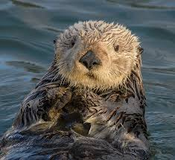
Welcome to Class 3
Otter Class
Term 1 - 2025
Mrs. Wright (Mon, Tues, Wed, Fri), Mrs. Wingfield (Thurs)
Miss Newstead (Mon-Fri), Miss Turner - TA (Mon PM, Tues, Wed, Thurs, Fri) Mrs London – TA (Mon)

Slide 2

Class 3
Learning class rules and routines
Well-being – getting to know each child as an individual, different needs,
Need to be happy to learn best
Varied activities
Outdoor learning as well as indoor/practical
Children work with different children for different lessons
Growth mindset (encourage independence, resilience & perseverance)

Slide 3
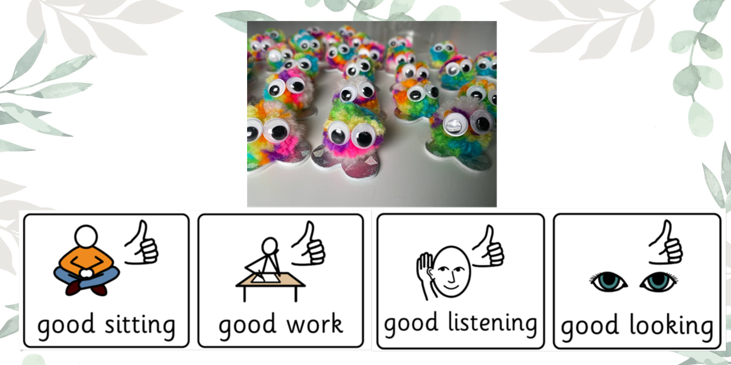
Behaviour and Expectations
Behaviour policy is available on our school website. It is very positive and focuses on praise and reward
Continuing to use house points and gold stars given out during celebration assembly on Fridays
Courtesy and Minerva cups awarded each week
In addition, we have our mini monsters!

Slide 4

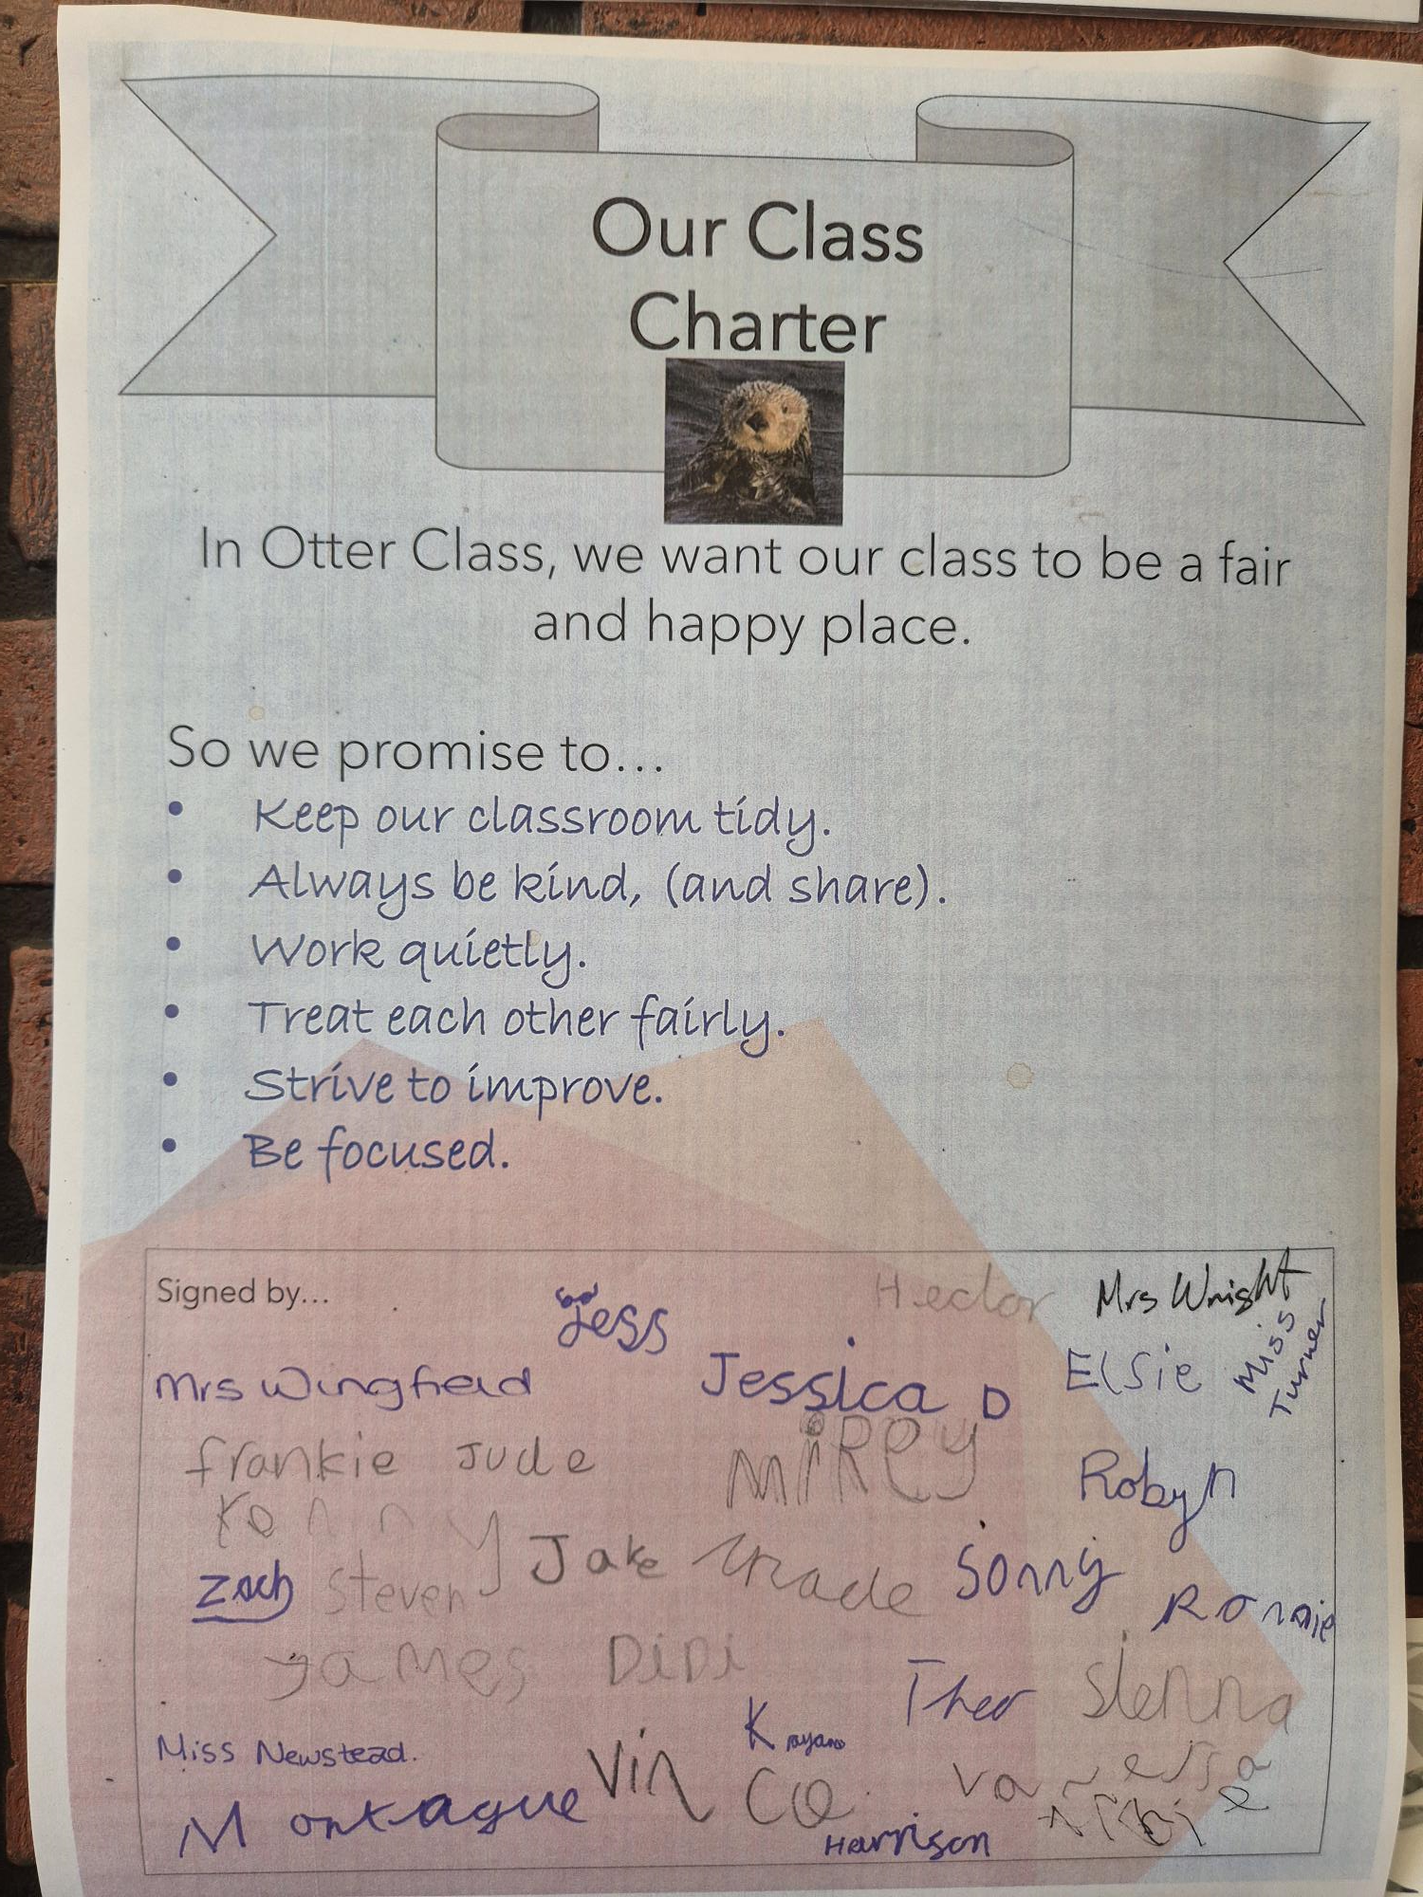
Class Charter
Class rules chosen by and agreed by the children:
We promise to..
Keep our classroom tidy.
Always be kind, (and share).
Work quietly.
Treat each other fairly.
Strive to improve.
Be focused.

Slide 5
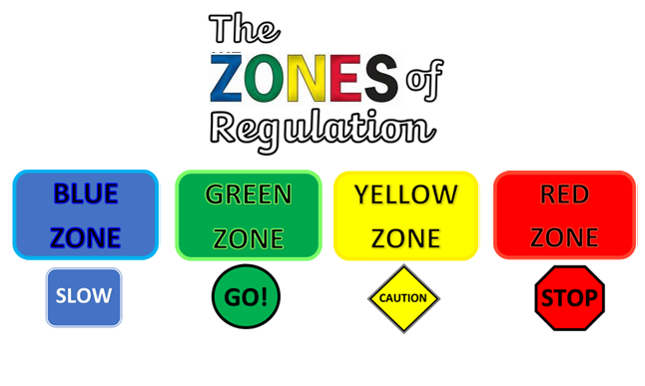
Zones of Regulation

Slide 6
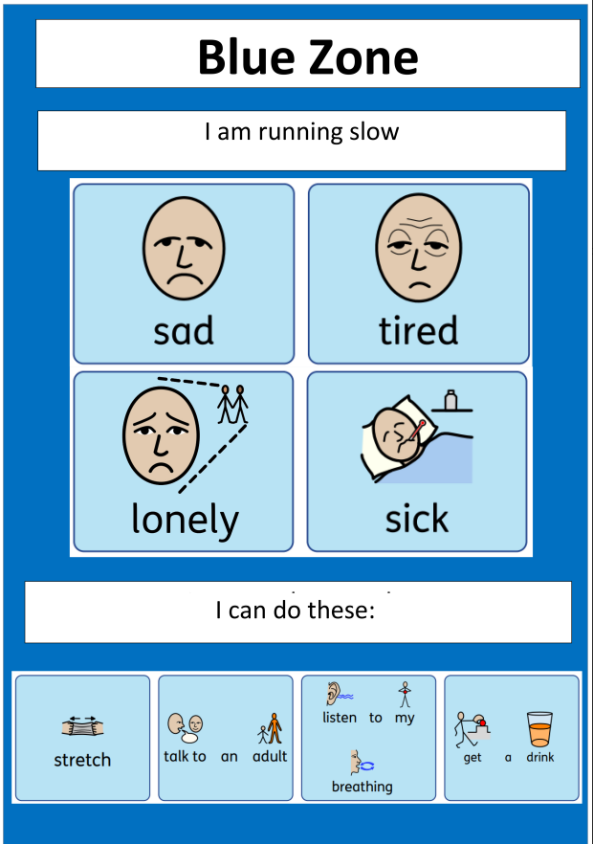
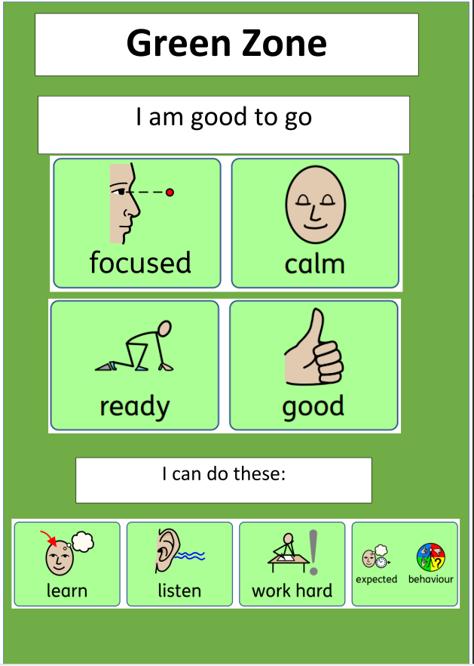
Zones of Regulation

Slide 7
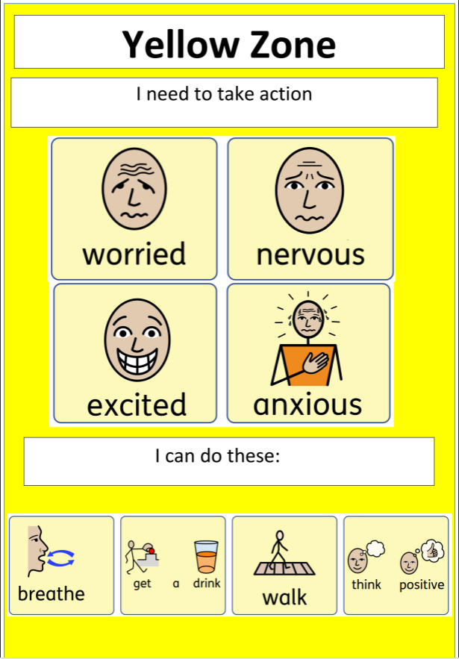
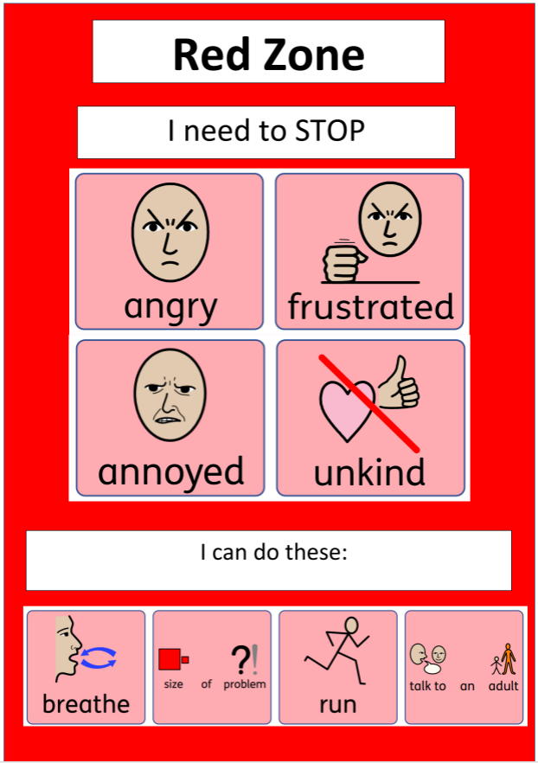
Zones of Regulation

Slide 8

Curriculum

Slide 9
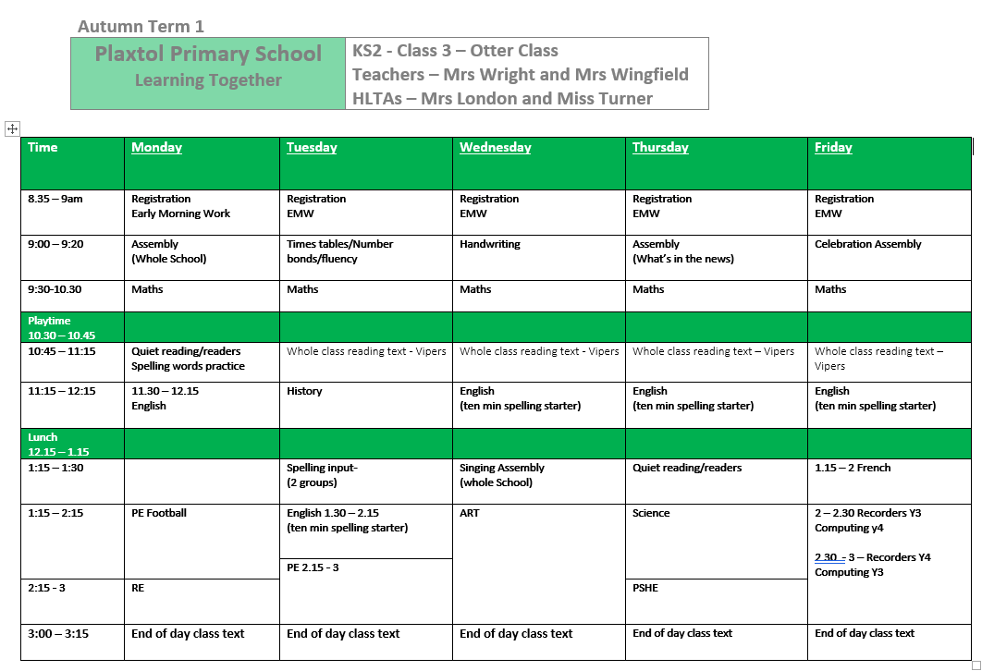
Class 3 Timetable

Slide 10
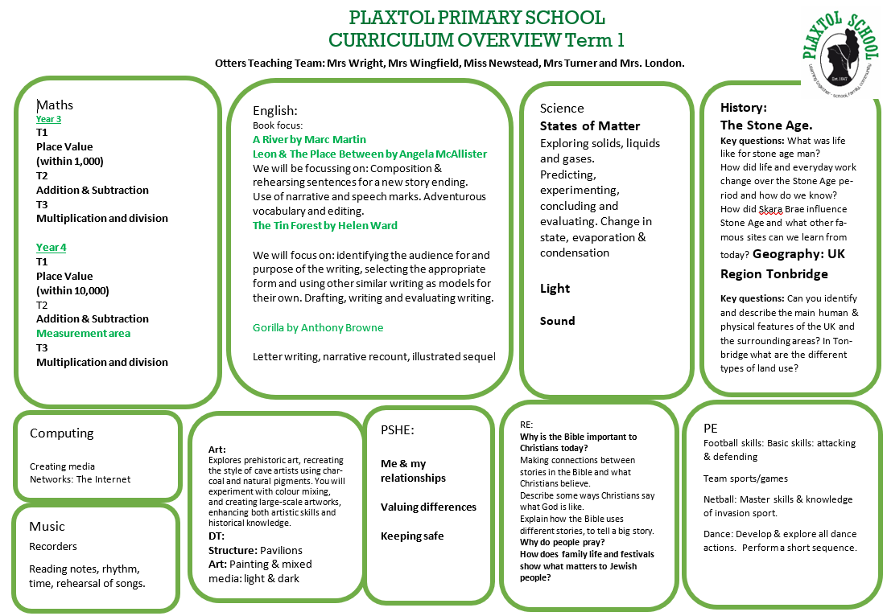

Slide 11



Reading
Whole class comprehension based on a text each term
Detectives using VIPERS, exploring and using the following skills:
Vocabulary
Infer
Predict
Explain
Retrieve
Summarise
At home -read for 10 minutes each day
Daily reading to an adult for those who need more support
1:1
Our aim is to read on a 1:1 basis with all children during the week.
Hold a sentence
Whole class shared writing
Read and improve sentence
Independent sentence writing

Slide 12


English
Learning:
Reading Objectives:
Predicting what might happen from details stated and implied.
Identifying how language, structure, and presentation contribute to meaning.
Discussing words and phrases that capture the reader’s interest and Imagination.
Checking that the text makes sense to them, discussing their understanding and explaining the meaning of words in context.
Identifying main ideas drawn from more than one paragraph and summarising these.
Spoken language objective:
Use spoken language to develop understanding through
imagining and exploring ideas.

Slide 13


Grammar Objectives
Introduction to inverted commas to punctuate direct speech.
Noun phrases expanded by the addition of modifying adjectives, nouns and preposition phrases.
Cards and doves fluttered in the lantern light.
Use of –ly in Standard English to turn adjectives into adverbs.
Grammar Objectives
Introduction to inverted commas to punctuate direct speech.
Noun phrases expanded by the addition of modifying adjectives, nouns and preposition phrases.
Cards and doves fluttered in the lantern light.
Use of –ly in Standard English to turn adjectives into adverbs.
Planning. Drafting and Editing Objectives
Discussing writing similar to that which they are planning to write in order to understand and learn from its structure, vocabulary and grammar.
Discussing and recording ideas.
Composing and rehearsing sentences orally (including dialogue), progressively building a varied and rich vocabulary and an increasing range of sentence
structures.

Slide 14


Spellings
Each week we are teaching a new spelling practice. We have 2 groups, taught is separate rooms. We will be building up to having one long lesson and 3 short activities to help with their learning, consisting of a ‘hold a sentence’, online games, and dictation.
There will be games set on Spelling Shed to support this.
Please note, that it’s not always the ability to ‘say spell’ the word but to use it correctly in writing as well.
There will also be weekly homework set on Maths Shed to support the term’s topic of learning in class.

Slide 15


Times Tables
Year 4 will have a Times Tables assessment of all the times tables in June. This consists of 25 questions and will be timed.
Any practise at home will help them greatly!
The class will have access to the site: Times Tables Rock Stars.
This has fun games to help the children to learn their times tables.

Slide 16
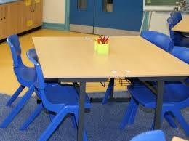
Working at tables
The children are working at tables in mixed year groups.
They each have a clear pencil case in their trays to eliminate looking for equipment at the beginning of lessons or getting up to find things.
There are labelled trays with equipment specific to subjects, such as maths, available for children to choose from when needed.
The children have a jotter book in their tray, to record ‘in class reading’ and to make notes in lessons or to doodle, (when appropriate).

Slide 17


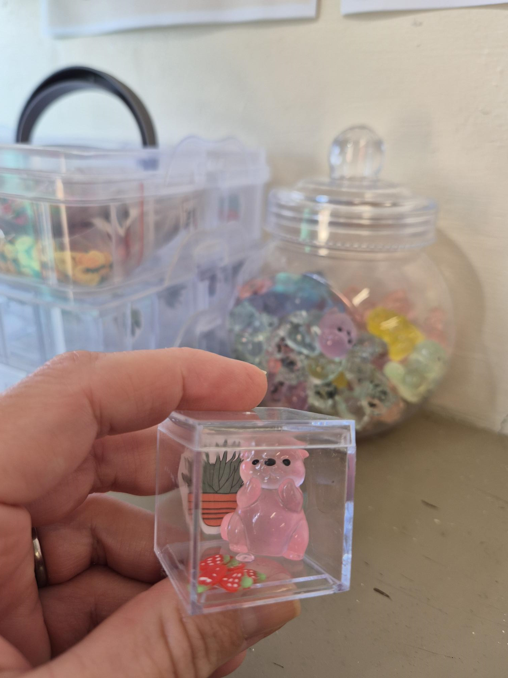
Desk Pets
Mrs. Wingfield has set up this lovely new initiative to encourage your child to read at home. The children are very excited about this!!
Tapestry is used for sharing general information and reminders, a weekly newsletter and occasionally, photographs of the children ‘learning in action’.
We are also happy for the children to share work or photos with staff or you may upload photos for them to share with their peers in class.
Please just pop a note on to say they wish to ‘show and tell’ to the class.

Slide 18
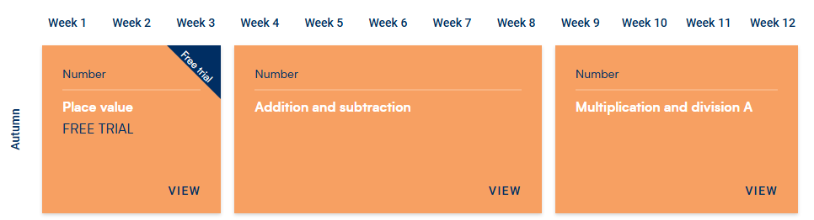
Year 3 Maths Overview

Slide 19
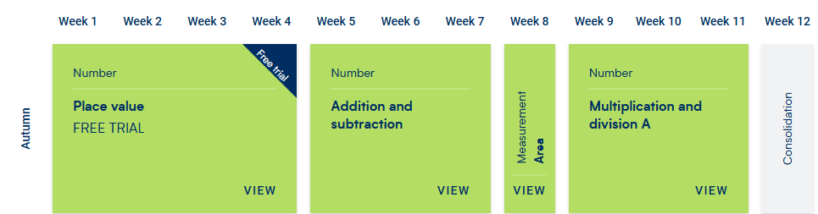
Year 4 Maths Overview

Slide 20
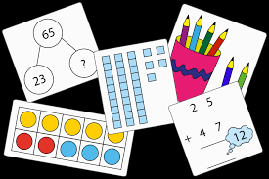
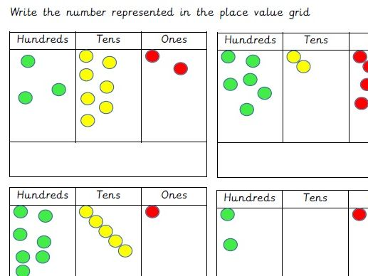
Maths
Practical resources & pictorial representation
Include reasoning/problem solving
Growth mindset
Begin to independently select the most appropriate
strategies and resources
Mastery/long term memory

Slide 21
Home–school links
Home-learning
Reading 10 minutes daily and record in reading records
Maths/spelling home-learning on Ed Shed
Contact –
Tapestry - (if urgent, contact school office)
Weekly Newsletter
Chat at the end of the day

Slide 22

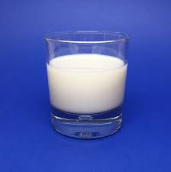
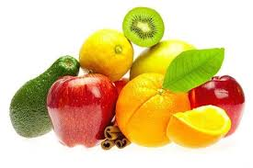

Other information
Water bottle
Snack – Snacks are not provided in KS2. Please send your child in with a snack from home, it must be a fruit, or
vegetable-based snack.
Coat – everyday
On Fridays from this week, the class have recorders lessons. Recorders are provided by the school. The children will have their own, labelled recorder. These have all been washed beforehand.
Early Morning and After school club - Please book a place and make payment in advance via your parent mail account.

Slide 23
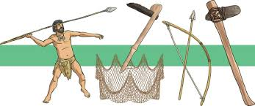
Looking ahead
Staff from the Maidstone Museum will be visiting Class 3 on Tuesday 7th October, to run a workshop about the Stone Age period.

Slide 24
Computer and internet safety
Please refer to the following link regarding keep children safe online.
We will be teaching Internet Safety at school throughout the year but we ask that you read the information in this link to the NSPCC.
https://www.nspcc.org.uk/keeping-children-safe/online-safety/talking-child-online-safety/

Slide 25

Thank you……

