Slide 1

Rabbit Class Parent Talk

Slide 2
Adults
Mrs Black – teaches 4 days a week.
Early Years specialist
Miss Cleisham – teaches Thursday. Early years trained and Early Years specialist
Mrs Millett – Teaching Assistant Monday
Mrs Hammerton– Teaching Assistant Tuesday – Friday
Miss Harvey – Volunteer helper every morning

Slide 3
Behaviour and Expectations
The first few weeks and months will be spent settling children in, setting expectations and creating a whole class ethos and culture.
Behaviour policy is available on school website.
Incredibly nurturing and focus primarily on praise and reward.
We will celebrate children’s good behaviour and acts of kindness and helpfulness.
We will give children marbles to put in the jar throughout the day.
There will be Headteacher Awards in Friday assemblies.

Slide 4
Classroom
Different areas within the indoor and outdoor area. The children ‘free-flow’ and choose their area for learning.
Lots of floor space for the children to spread out.
Quality resources accessible by the children.
Language and vocabulary rich environment.
Resources enhanced throughout each week according to what the children have been doing.

Slide 5
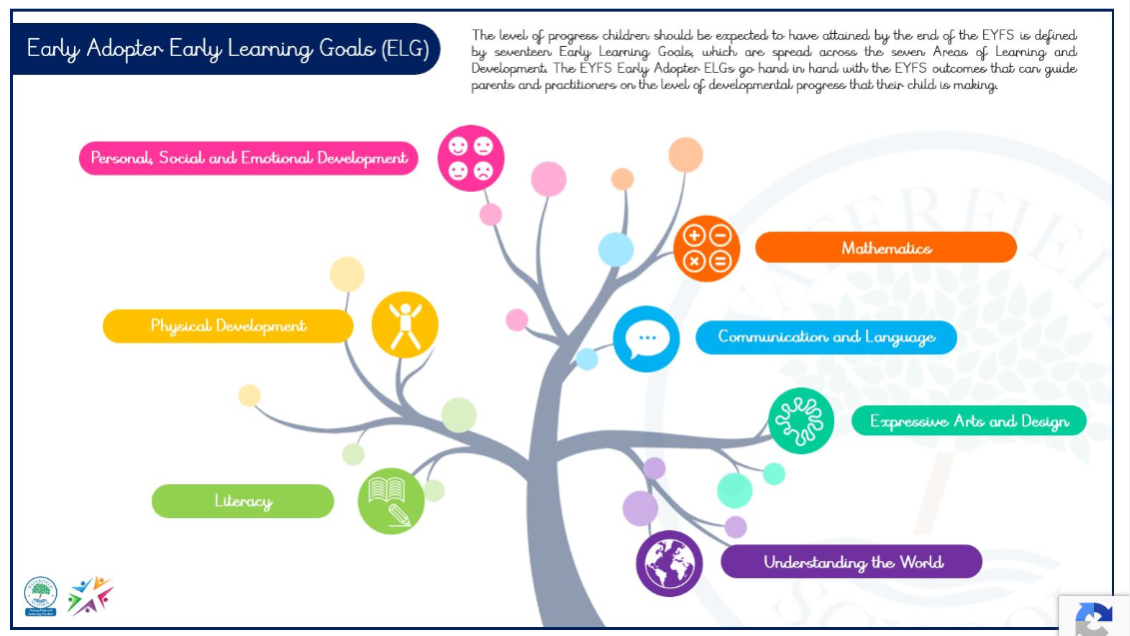
EYFS Framework
hyperlink

Slide 6
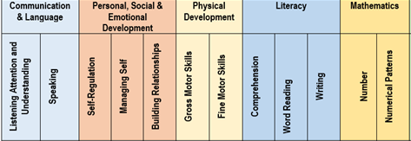
Early Learning Goals - ELG
The Early Learning Goals (ELGs) are the goals or targets for children to achieve at the end of their reception year.
The ELGs should be used as an assessment during the summer term/at the end of the reception year.
There are 17 ELGs across all the areas of learning, however GLD (Good level of development) is calculated using 12.
hyperlink

Slide 7
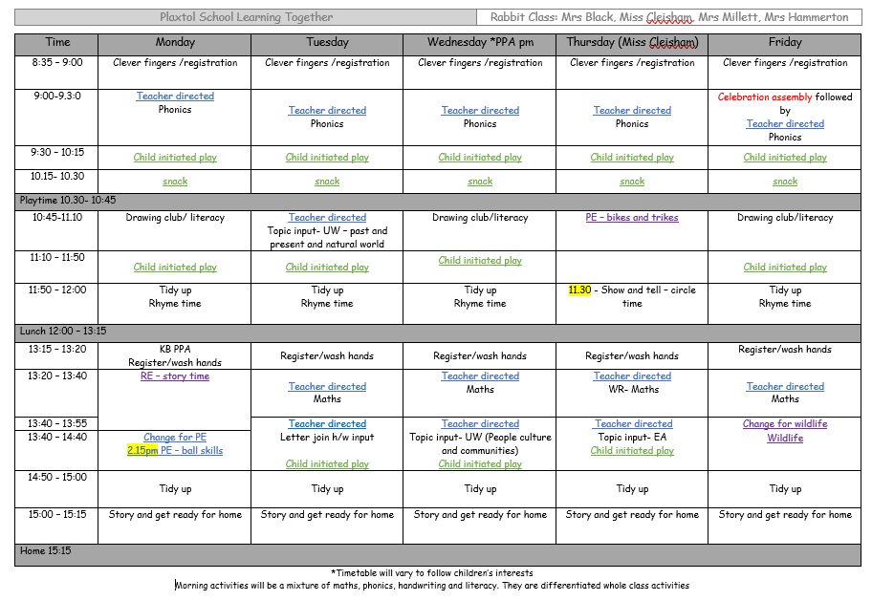
A typical day…

Slide 8
Curriculum

Slide 9
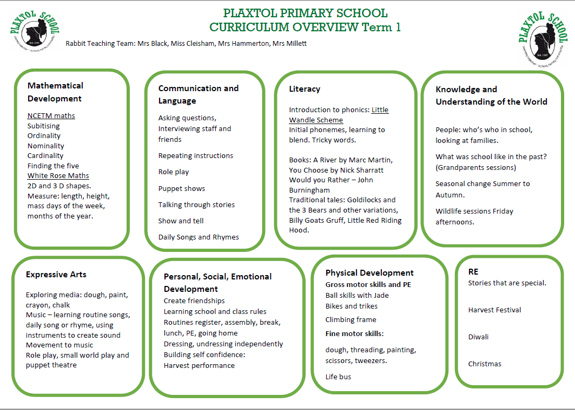

Slide 10
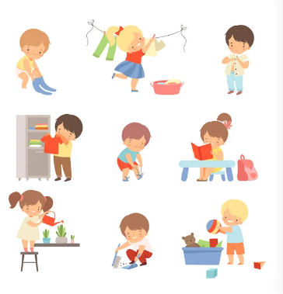
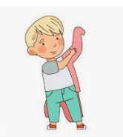
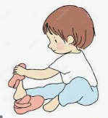

Independence
Independence is an essential life skill and one that needs to be nurtured from an early age. The term is often understood to mean a range of skills, from helping children to be apart from their families to developing skills in dressing and encouraging them to think for themselves.
hyperlink

Slide 11
Early Learning Goals – Maths
Number
• Have a deep understanding of number to 10, including the composition of each number.
• Subitise (recognise quantities without counting) up to 5.
• Automatically recall (without reference to rhymes, counting or other aids) number bonds up to 5 (including subtraction facts) and some number bonds to 10, including double facts.
Numerical Patterns
• Verbally count beyond 20, recognising the pattern of the counting system.
• Compare quantities up to 10 in different contexts, recognising when one quantity is greater than, less than or the same as the other quantity.
• Explore and represent patterns within numbers up to 10, including evens and odds, double facts and how quantities can be distributed equally

Slide 12
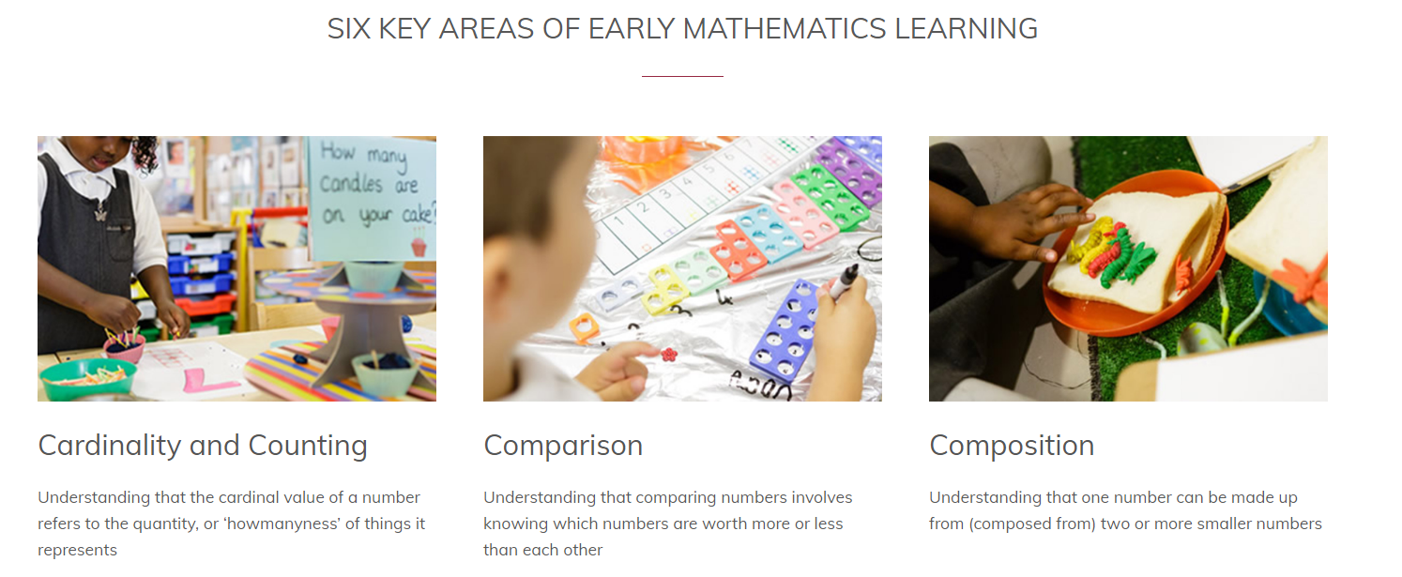
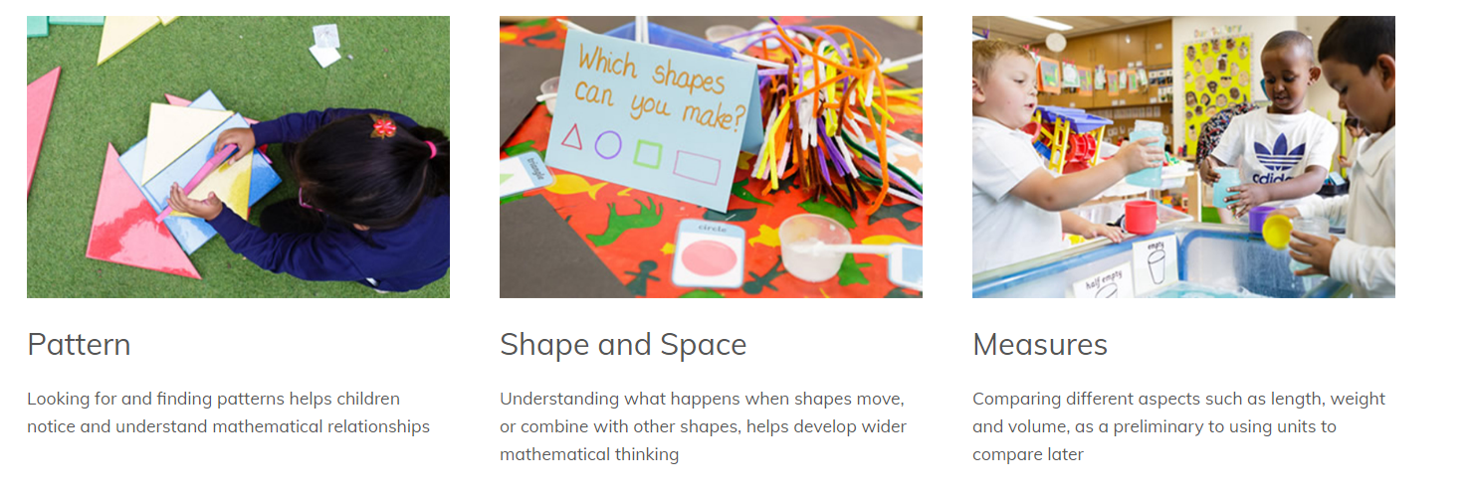
NCETM maths
Ensuring that all children develop firm mathematical foundations in a way that is engaging, and appropriate for their age.

Slide 13
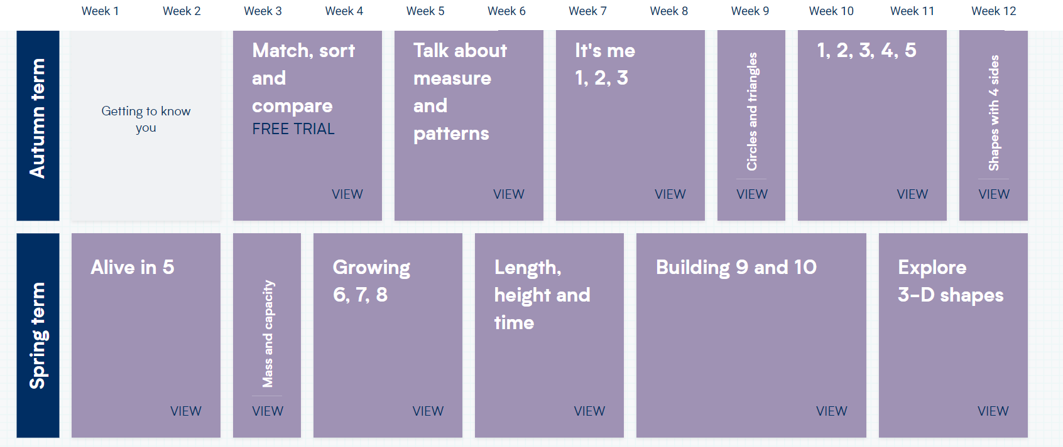
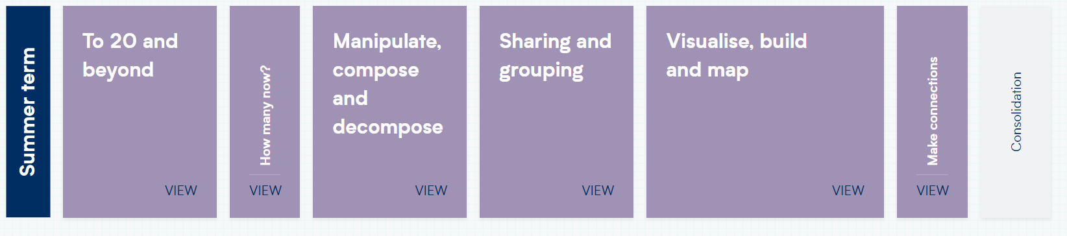

White Rose Maths
hyperlink

Slide 14
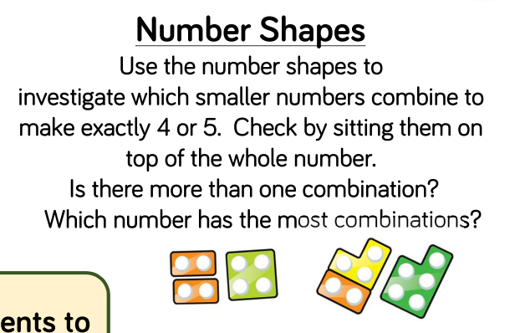
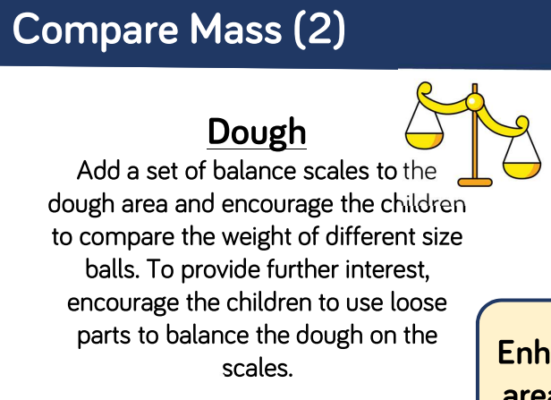
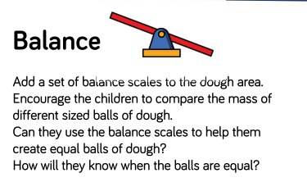
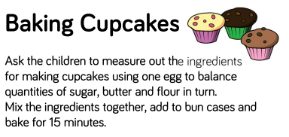
Practical
Hands on

Slide 15
Early Learning Goals for Literacy
Comprehension
• Demonstrate understanding of what has been read to them by retelling stories and narratives using their own words and recently introduced vocabulary
• Anticipate key events in stories
• Use and understand recently introduced vocabulary during discussions about stories, non-fiction, rhymes and poems and during role-play.
Word Reading
• Say a sound for each letter in the alphabet and at least 10 digraphs
• Read words consistent with their phonic knowledge by sound-blending
• Read aloud simple sentences and books that are consistent with their phonic knowledge, including some common exception words.
Writing
• Write recognisable letters, most of which are correctly formed
• Spell words by identifying sounds in them and representing the sounds with a letter or letters
• Write simple phrases and sentences that can be read by others.

Slide 16

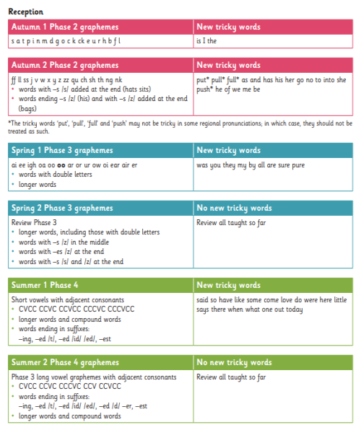
Little Wandle
Overview
• Term by term progression of GPCs (Grapheme Phoneme Correspondence).
• Organised so that children are taught from the simple to more complex GPCs plus tricky words.
• All the graphemes taught are practised in words, sentences, and later on, in fully decodable books.
• Review and revise GPCs and words, daily, weekly and across terms and years, in order to move this knowledge into their long term memory.
• Children need to learn to read as quickly as reasonably possible, so they can move from learning to read, to reading to learn.
• Our expectations of progression are aspirational yet achievable - pace, practice and participation by all children.
• Children who are not keeping-up with their peers will be given additional practice immediately through keep-up sessions.

Slide 17
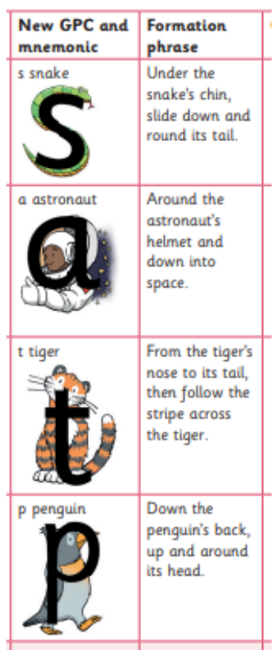
• Every letter has a name
• Every letter has a phoneme – sound
• Every letter has a mnemonic – picture
• Every letter has a formation phrase

Slide 18
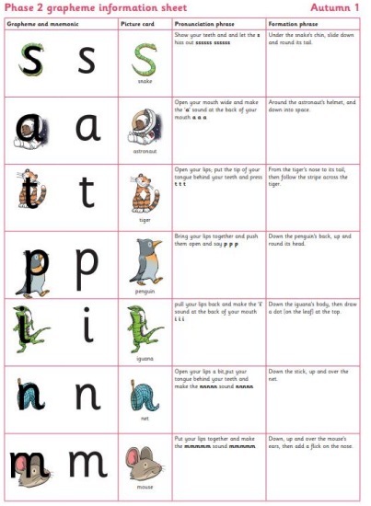

Pure Sounds
This video shows you how to pronounce the sounds. Notice how the children don’t add an ‘uh’ sound at the end, so they say: ‘t’ not ‘tuh’.
https://youtu.be/shlSQrleibs
hyperlink

Slide 19
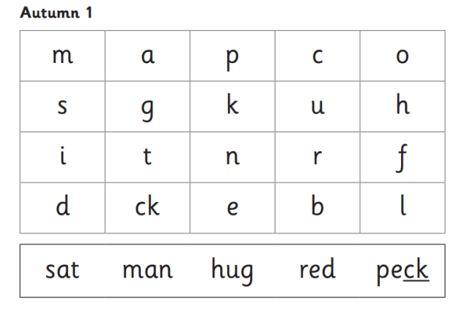
Tracking
All children will be tested 1:1
• Must know a given amount of phonemes
• Must be able to read a given amount of words
• Keep up sessions provided to fill in the gaps

Slide 20

What is segmenting and blending?
Blending: Seeing a word and merging the phonemes together to read the word
Segmenting: Chopping up a word into separate phonemes to spell it out
hyperlink

Slide 21
Phonics Terminology
Phonemes: The sounds that are found within a word (often referred to as sounds)
Grapheme: The way we write down a sound
Digraph: Two letters that make one sound (such as ai)
Trigraph: Three letters that make one sounds (such as igh)
Blending: Seeing a word and merging the phonemes together to read the word
Segmenting: chopping up a word into separate phonemes to spell it out
Tricky words: words that cannot be decoded (such as ‘the’)
Decoding: the process of working out how to say (''sounding out'') an unfamiliar written word
Spelling: writing words using the correct letters in the right order to be read by others.
CVC/VC: Consonant vowel consonant words and vowel consonant words. c-a-t and i-t for example. But c-ar would not be as we look at sounds.

Slide 22
Phonics Packs
Phonics packs will come home this Thursday with the first 4 sounds in them.
It is best practise to use these packs on a daily basis by practising recognising the new phonemes with your children, writing the grapheme using the correct technique and playing games finding objects beginning with that sound in your house.
Please bring the packs into school daily and 4 new sounds will be added every Thursday.

Slide 23

The reading practice book
• It is the school’s role to teach reading.
• Parents/carers play a vital role. It is important that children have plenty
of practice reading at home in order to become fluent, confident readers.
• Parents’ or carers’ support is needed to help their child practise reading
and develop fluency with a book they have already read at school.
• This book needs to be matched to their phonic stage and be fully
decodable. If books are sent home that the child cannot decode, it will lead
to frustration for the child and the parent/carer.
• To ensure that reading at home is an enjoyable experience and does not
feel like a chore, schools need to send home reading practice books in
which the child can read 95% of the words.
• It does not have to be a different book every time; it may need to be the
same book if the child still needs to develop fluency.

Slide 24
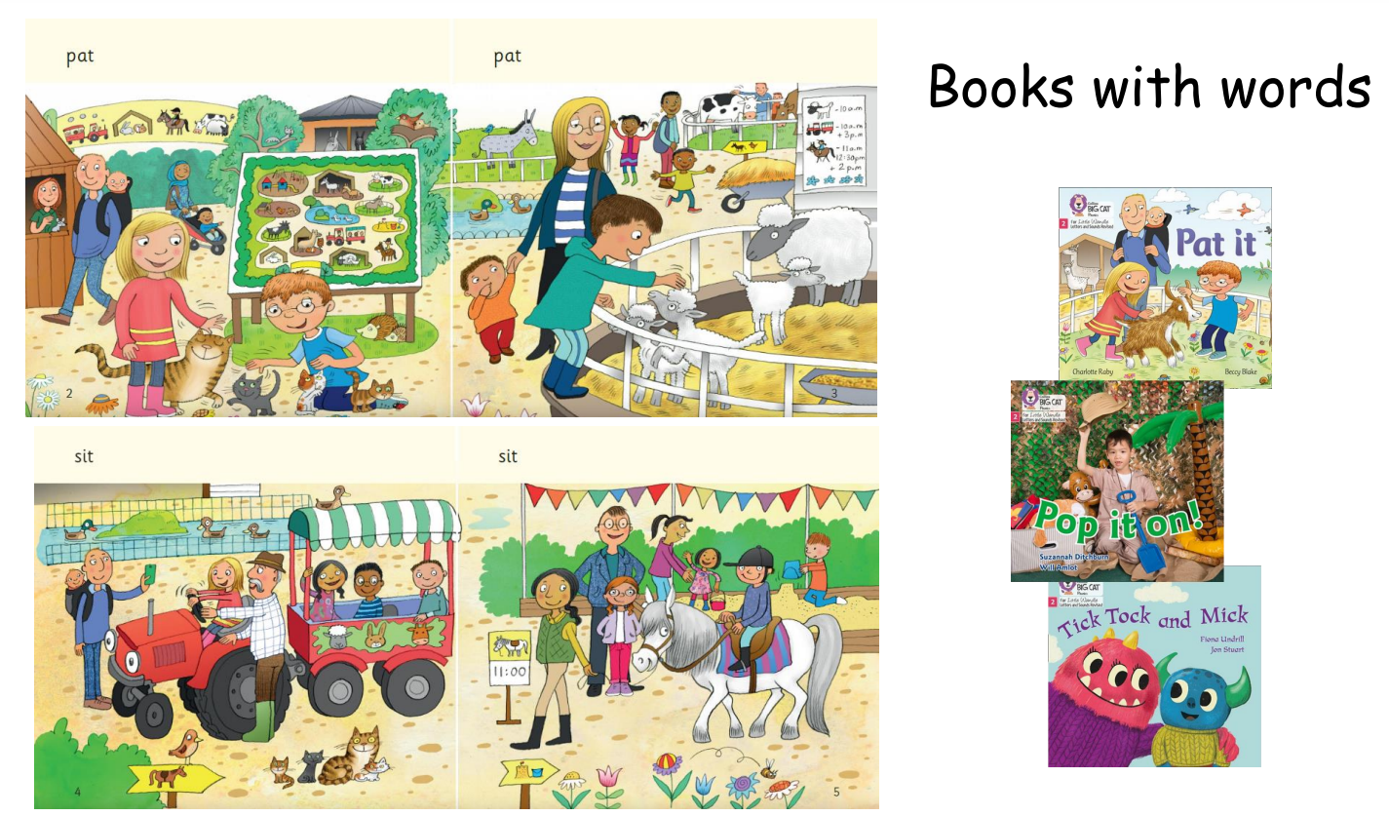

Slide 25

The sharing book from the class library
If children are to become lifelong readers, it is essential that they are encouraged to read for pleasure. The desire of wanting to read will help with the skill of reading.
Parents/carers should not expect their child to read
this book independently and certainly should not try to
get their child to do so.
The book is for the parent/carer to read to or with the child.
The goal is enjoyment.
These are the books we sent home last week. We will encourage the children to change their books every Monday and Thursday.

Slide 26
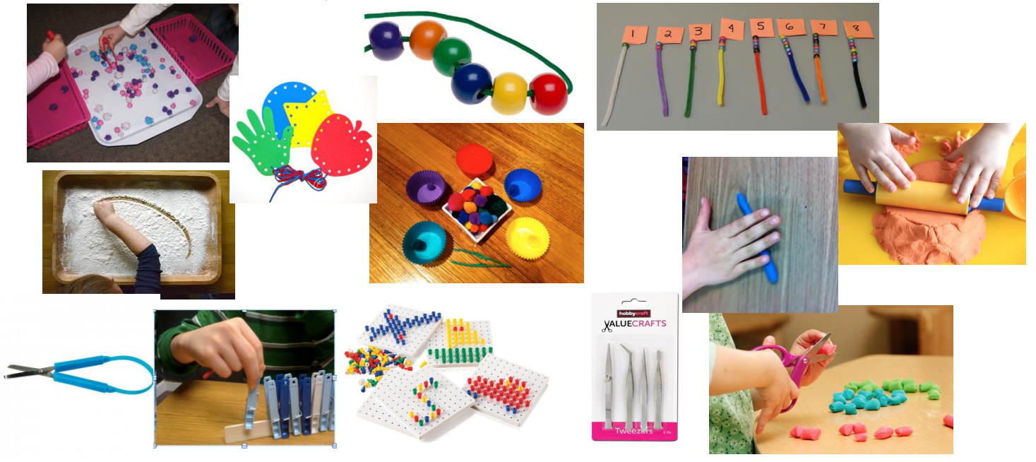
Writing activities
Strengthening their fine motor skills and pre-writing skills - daily clever fingers in groups as they arrive at school.

Slide 27
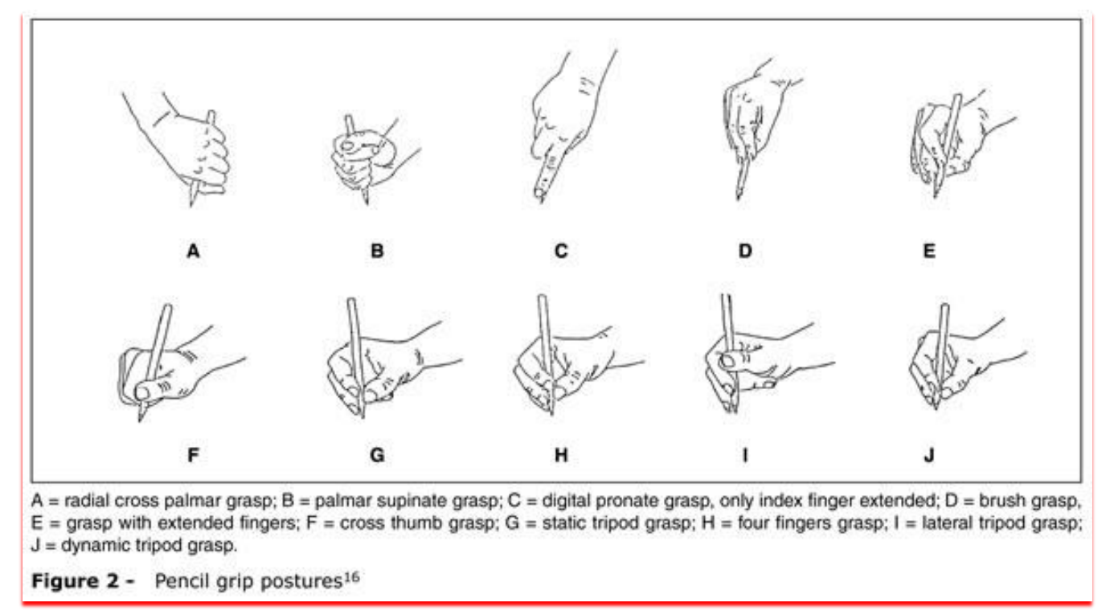
These pictures show the different pencil grips that children may use. We are aiming for all children to be comfortable using grip J. We are encouraging the children to hold their pencil this way using pompom pets and special pencils.

Slide 28
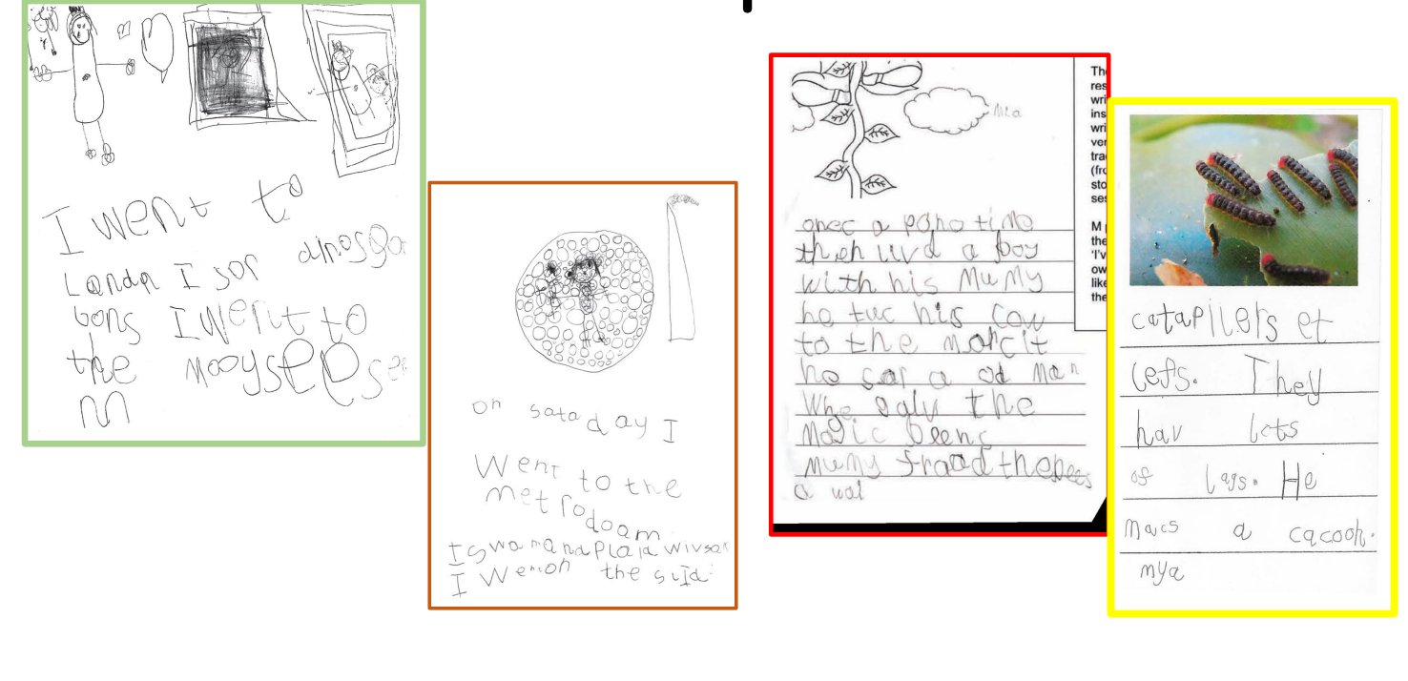
Examples of writing we might see at the end of Reception Year

Slide 29
Drawing Club
Is a literacy session we will use 3 times a week.
It is based on a book, story telling or an animation.
It involves modelling by the teacher, mark making and mathematics.
Most of all it involves the children using their imagination and enjoying literacy.

Slide 30
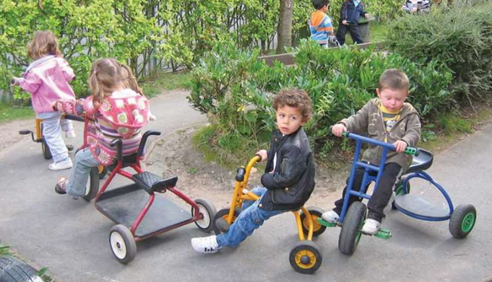
Physical Development
Gross motor skills
2 Specific PE slots a week timetabled: this term we are doing
Ball skills with specialist sports teacher Jade on Mondays
Trikes, bikes and scooters on Thursday
Lots of other opportunities to climb, build, run and jump in continuous provision time.
Fine motor skills
Daily clever finger sessions

Slide 31

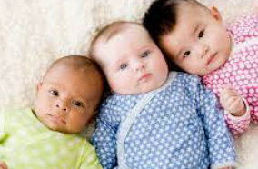
Understanding of the world
People, culture and communities - thinking about our school, our families and our village and comparing stories from other cultures
Natural world – Exploring the 5 senses, seasonal change, harvest. We have wildlife sessions every Friday afternoon this term.
Past and present – what we were like as babies, what can we do now

Slide 32

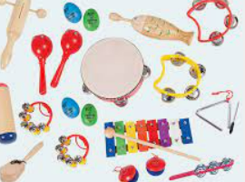
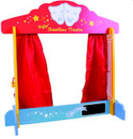
Expressive Arts
Colour– exploring different media (paint, chalks, pencil, dough), mixing colours, observational drawings, junk modelling
Music – learning rhymes and songs, composing and appreciating music
Drama –role play, puppets, re-telling stories

Slide 33
Things to remember:
Thursdays – show and tell with Miss Cleisham. Children to bring in an object that they can talk about or send in a photo via tapestry. Not just a toy and it must fit in the bucket.
Friday – Wildlife with Mrs Hammerton, Please bring in a pair of wellies to keep at school. Also provide a pair of trousers and a coat, as we will be outside whatever the weather.
Book bags – bring in every day. Please don’t carry water bottles in them as books can be ruined by leaky bottles. Please don’t bring in toys from home as they may get confused with school resources.
Lunches –Encourage your child to eat with a knife and fork at home, we are working on this skill at school too.
Please ensure packed lunches are healthy.

Slide 34
All communication from the class will be via Tapestry, including the weekly newsletter. Please can you acknowledge any messages with a comment or use the ‘like’ icon.
Early Morning club 8-8.35am (no breakfast)
After School club 3.15-6pm includes a sandwich and snacks.
Both with Miss Turner.
Must be booked in advance up to midnight before.
Please book a place and make payment via your parent mail account.

Slide 35
Upcoming events
w/c 15th September -Family book week – please provide a family photograph (hard copy or send via tapestry) for our class book.
Fri 26th September -Macmillan coffee morning - parents welcome to come and enjoy a drink and cake to support this charity
Wed 8th October 9am Harvest assembly – Parents invited to watch their child. We are doing a song and joining the rest of the school in this celebration.
Wed 15th October 3-6pm Parent consultations – a chance for you to meet with me to discuss how your child has settled in.

Slide 36
Computer and internet safety
https://www.nspcc.org.uk/keeping-children-safe/online-safety/talking-child-online-safety/

Slide 37
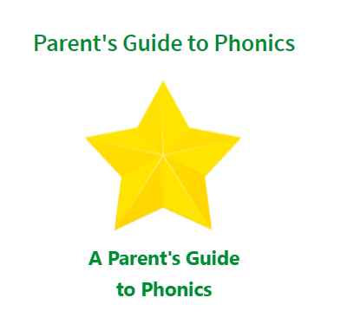

Any Questions?
A copy of this PowerPoint will be available via tapestry
Our class page on the website contains information and links about our phonics scheme Little Wandle
hyperlink

