Slide 1
How to save the world
23.3 million animals die each day.

Slide 2
How to save the world.
Costa is very BAD for environment because of the disposable cups.

Slide 3
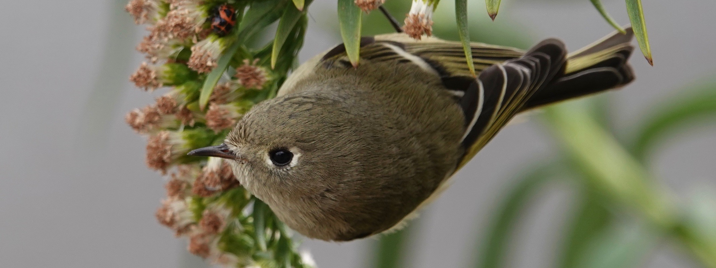
BIRDS
Say no to deforestation

Slide 4
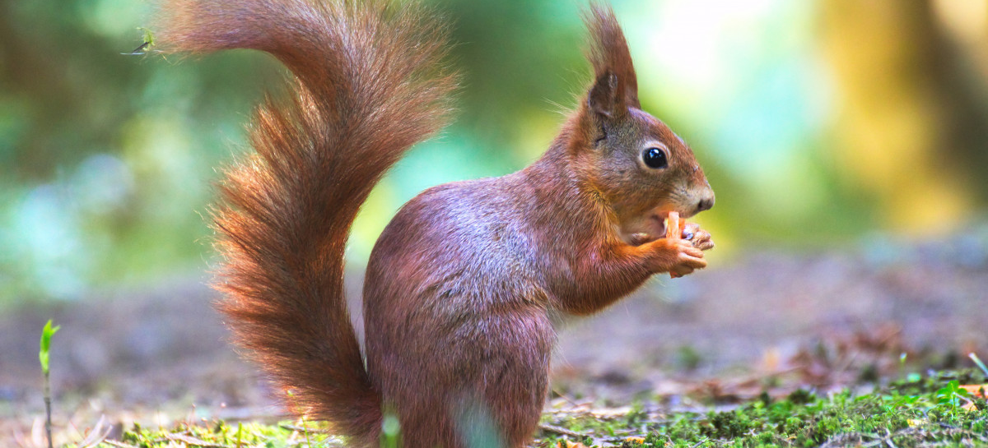
When trees are cut down more animals die.

Slide 5
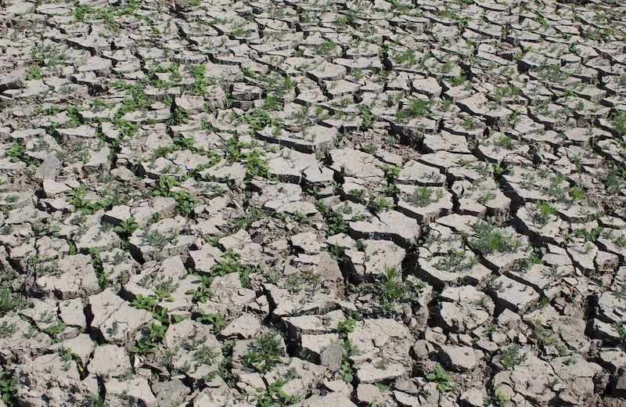
Climate change
The summer was so hot, that was because of climate change

Slide 6
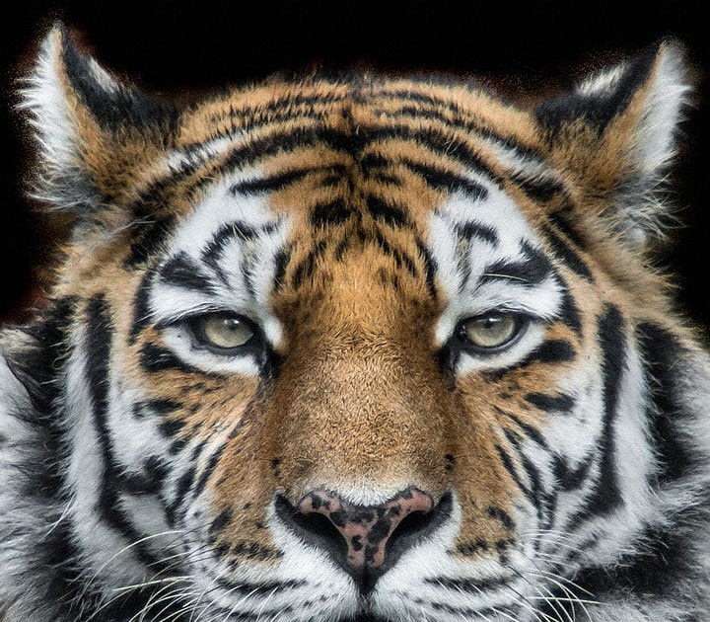
Animal TESTING.
Some things are tested on animals .But they do not say on the packaging.
This Photo by Unknown Author is licensed under CC BY-NC-ND

Slide 7
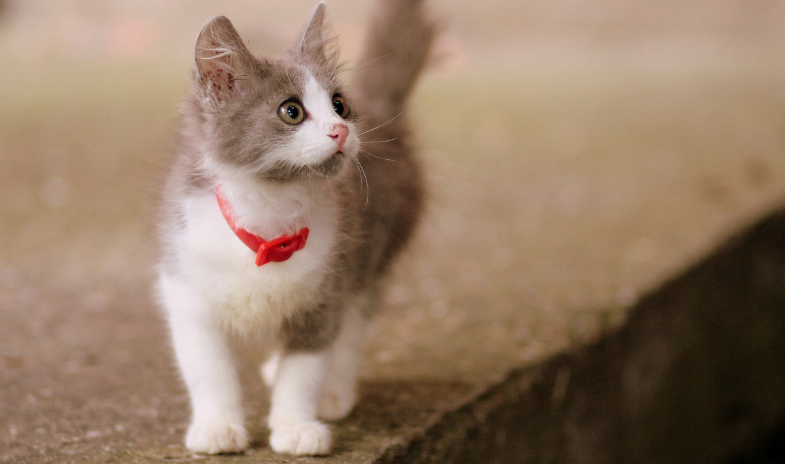
THANK YOU FOR watching! BY EVA

