Slide 1

Welcome to Plaxtol Primary School
Mrs Claire Rowley
Headteacher
Mrs Natalie Spratt
Assistant Headteacher
EYFS Teacher
Mrs Black

Slide 2
Minerva Vision
Our School Motto:
Learning together – school, family, community
Our Vision
M – we use a Growth Mindset attitude to learning, where resilience is key.
I – we promote independence in both the children’s learning and their approach to later life.
N – we pride ourselves on how we nurture the potential of every child.
E – we recognise the importance of the environment both on a local , national and global level.
R – we will respect all pupils and adults in our school and the wider community.
V – our village is fundamental in developing a sense of community.
A – all children, parents and staff are aspirational in their outlook.

Slide 3
Plaxtol Primary School
We are a small rural community primary school benefitting from strong community link and lots of outside space.
Our children are split into 4 classes:
Rabbit Class (Year R – 15 children),
Hedgehog Class (Year 1 + Year 2),
Otter Class (Year 3 + Year 4)
Badger Class (Year 5 + Year 6 )
We have wraparound care from 8am - 6pm onsite run by our staff.
We have an onsite kitchen that all our lunches are freshly prepared in each day.

Slide 4
Our School
The children are each assigned a house when they join in Reception: Hawks, Swallows, Woodpeckers and Robins. Our Year 6 children have the opportunity to be elected as House and Vice Captains.
Each week we gather for a whole school Celebration Assembly to celebrate the children’s achievements. Children are awarded Gold Stars in Reception/KS1 and achievement certificates in KS2.
The Courtesy cup is awarded weekly to the child who is polite with the best manners.
The Minerva Cup is awarded weekly to a child showing a different aspect of the vision e.g. for mindset/ independence/ nurture/ environment/resilience/village and being aspirational.

Slide 5
Music
In Year 3 and 4 children learn the recorder and perform to their parents in assembly.
In Years 5 and 6 we take part in ‘Young Voices’ at the 02 every other year , this is the largest children’s choir concert in the world.
Children can have private peripatetic music lessons during the school day.
Our parents are invited to join us for several celebration assemblies throughout the year (Harvest Festival, Easter) and enjoy a musical performance from each class as well as the children singing together as a school.
At Christmas, all parents are welcomed to our Carol Concert at Plaxtol Church.

Slide 6
Learning
Our curriculum focuses on developing a love of learning through engaging and imaginative lessons.
Our foundation subjects are planned on a 2 year cycle because of the mixed classes.
The children have the opportunity to work in groups, in pairs and independently.
They are active in their learning and understand that in order to progress they need to learn from their mistakes.
The children have access to 32 laptops and 32 iPads to support their learning in school.
Each class has an interactive whiteboard that the teacher uses.

Slide 7
Our family
Parents are an integral part of our school. We view parents as partners throughout their child’s learning journey at Plaxtol Primary School.
Each child in Reception is paired with a Year 6 ‘Buddy’ to help support them during their first year at Plaxtol Primary School. They will receive a letter from their buddy before they begin in September and then have many opportunities to build a strong friendship throughout the year.
All the children play together at playtime which gives a unique family feel to the school.

Slide 8
Responsibilities
Children from Year 1 to Year 6 have been elected as school council representatives. They meet several times each term to decide how to raise money for charities and to offer ideas. The children love the opportunity to be the voice for each year group.
Some of Year 5 are librarians and help in the library, as well as recommending books for other students to enjoy.
All Year 5 are also trained Sports Leaders, so they can support the children playing games at playtimes.
Year 6 have the opportunity to be elected as House and Vice Captains, as well as Head Prefects. As part of these roles, the children have been invited to previously take part in the Tonbridge Mayor’s Debate.

Slide 9
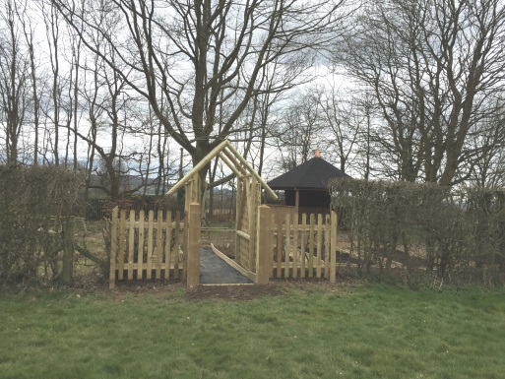
Parents School Association
As a school, we are very fortunate and our PSA raise an amazing amount of money through the activities they organise, such as the Christmas and Summer Fairs, school discos and termly cake sales.
The money raised has provided the school with incredible new resources for our Reception class and across the school. As well as supporting us with specialist learning opportunities with visitors to our school.
Recently we have had a new walking track added to the school field for the daily mile and a fabulous outdoor learning environment.

Slide 10
Our community
Plaxtol Primary School is at the heart of the community. Many of our children, staff and governors live in the village.
Peter the Rector leads some assemblies and at Harvest Festival we donated food to the St Johns Church foodbank in Hildenborough.
We have volunteer readers from the local area.
Local members of the community are on our Governing Body.

Slide 11
Enrichment
We have many clubs available such as Wildlife, Gymnastics, Sewing, Football, Netball and Dance.
We have a football and netball team who regularly compete against other local schools.
We have a P.E specialist who helps deliver PE lessons in school each week.
We have a ‘Wildlife’ area with a pond and a learning zone which all children have the opportunity to use.
Each year the children enjoy many extra curricular trips which include visits to the Houses of Parliament, the National Gallery and the Firefighting museum in Ash.

Slide 12
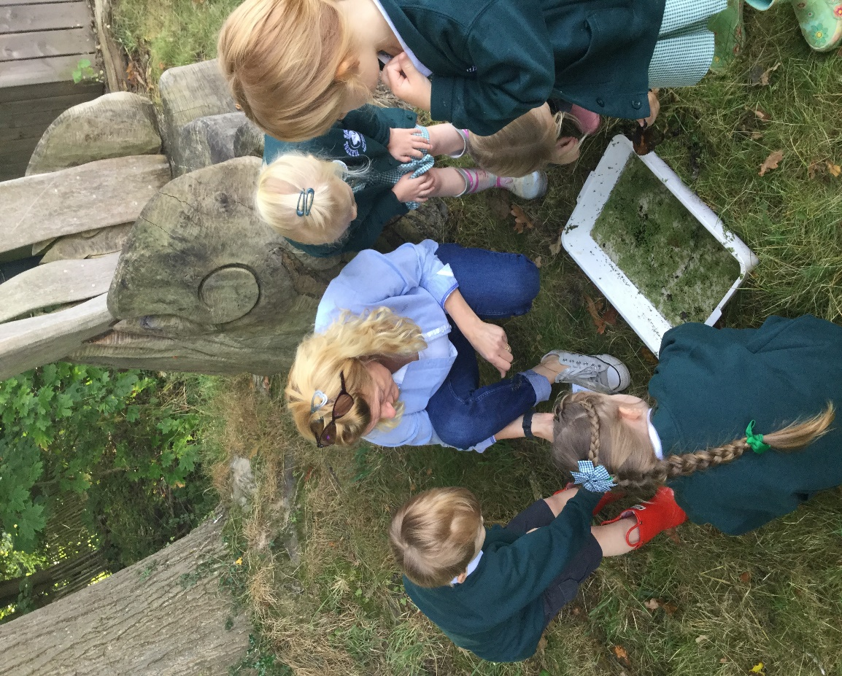
Wildlife area

Slide 13
Leavers
In recent years, at least 50% of Year 6 children have
passed the 11+.
Our children moved onto the following Secondary Schools:
Judd School
Leigh Academy
Hillview School for Girls
Bennett Memorial School
Sackville School
Hadlow Rural School
Trinity School
Tonbridge Girls Grammar
Tunbridge Wells Grammar School for Boys
Weald of Kent Grammar

Slide 14
Data
In June 2025, KS2 achieved the following results:
Reading expected 100%, greater depth 45%
National expected 75% greater depth 33%
Maths expected 100% greater depth 38%
National expected 74% greater depth 26%
Writing expected 85% greater depth 13%
National expected 72% greater depth 13%
Combined 85% greater depth 8%
National expected 62%, greater depth 8%

Slide 15
Ofsted Quotes
‘Good’ March 2023
We were confirmed as a ‘Good’ school in March 2023.
Pupils are well supported to become aspirational and independent learners in this welcoming school.
Leaders create a nurturing environment where pupils feel safe and are empowered to take risks in their learning.
Leaders and staff have high expectations for pupils to achieve and behave well.
Pupils work and play happily together in mixed aged classes.
Children in Reception settle quickly into learning and behaviour routines.

Slide 16
Parent survey November 2025
100% of parents would recommend the school.
100% agree their child is safe, happy and does well at school.
Happy with width of syllabus taught.
Caring and nurturing environment.
Communication is great.
All staff are approachable, knowledgeable and committed to supporting children’s learning.
Best decision I made sending them to Plaxtol.
Plaxtol School is a fantastic school.
Headteacher knows all the children and parents.

Slide 17
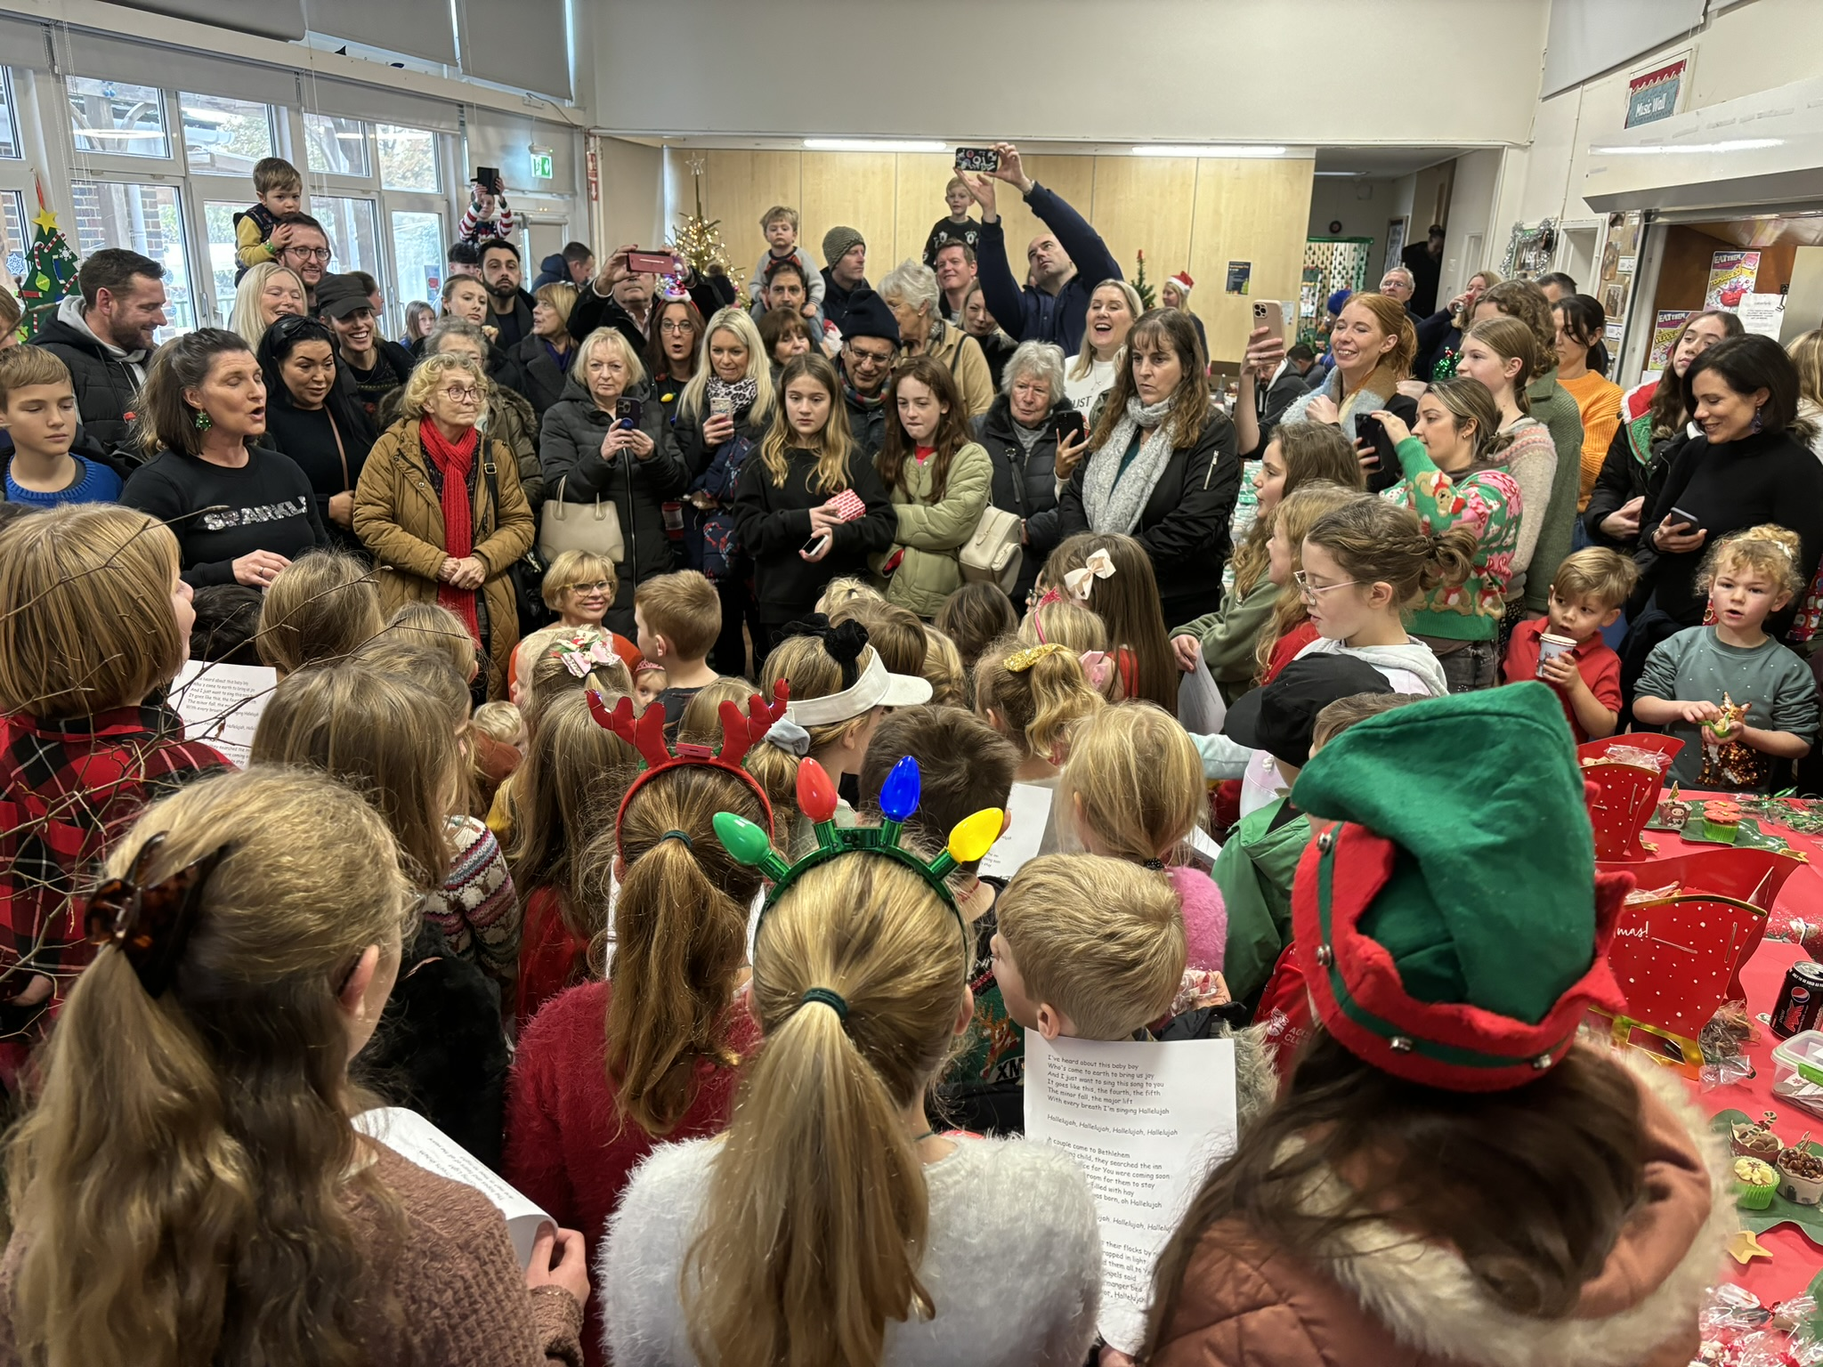
A community supporting the school
dads & mums
younger siblings
governors
staff
villagers
grandparents
former-pupils
pupils

